Slide 1
BSCS BSIT 1st Semester BSSE BSDS 3rd Semester
Applied Physics
Optics
Presented By
Dr. Arifa Mirza
Faculty of Computing & Information Technology

Slide 2
What Is Light?
Properties of light
Reflection - Mirrors
Refraction - Lenses

Slide 3
Properties of Light
Light travels in waves: A wave is a disturbance that transfers energy from place to place.
Light travels in straight lines
Laser

Slide 4
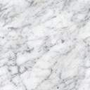
Light travels much faster than sound. For example:
Thunder and lightning start at the same time, but we will see the lightning first.

Slide 5
Light travels VERY FAST – about 300,000 kilometers per second or 186,000 miles per second.
At this speed light could travel the equivalent of 8 times around the world in one second!

Slide 6
We see things because they reflect light into our eyes! ALL objects we see either create light or reflect light!!
Homework

Slide 7
Properties of Light summary
Light travels in straight lines and is a form of energy
Light travels much faster (a million times faster!) than sound
We see things because they reflect light into our eyes
Light is a form of energy called Electromagnetic Radiation
Visible light is only a small part of the electromagnetic spectrum; the other parts are invisible to the human eye but not necessarily the eyes of other animals.

Slide 8
Reflection and Refraction of light waves

Slide 9
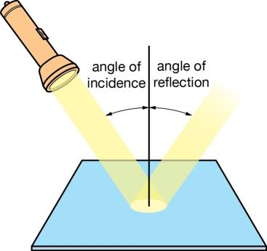
Reflection of light waves

Slide 10
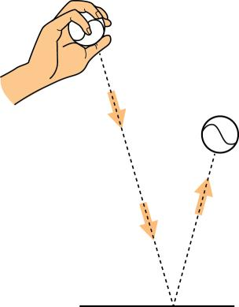
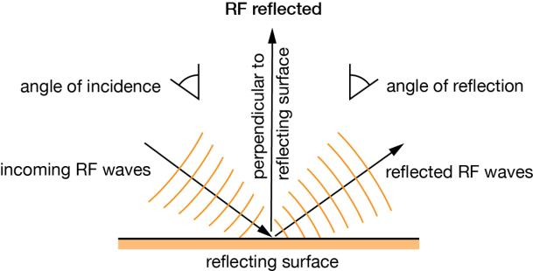
Reflection
For light,
angle of incidence i = angle of reflection r
angles measured with respect to a ‘normal’
Waves and particles are reflected in
exactly the same way.

Slide 11
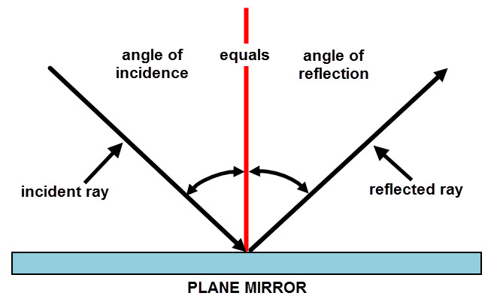
Reflection and Mirrors

Slide 12
The Law of Reflection
Angle of incidence = Angle of reflection

Slide 13
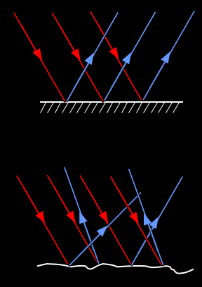
Regular vs. Diffuse Reflection
Smooth, shiny surfaces have a regular reflection
Rough, dull surfaces have a diffuse reflection.
Diffuse reflection is when light is scattered in different directions

Slide 14
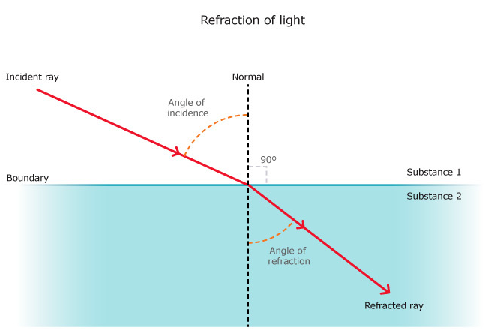
Refraction
Refraction is the bending of light (it also happens with sound, water and other waves) as it passes from one transparent substance into another.

Slide 15
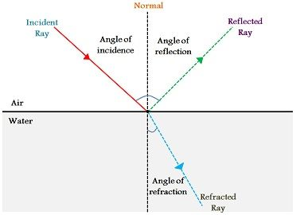

Slide 16
Refraction of light waves
Refraction is when waves speed up or slow down due to travelling in a different medium
A medium is something that light waves will travel through
Light rays are slowed down by the water
Causes the ruler to look bent at the surface
The mediums in this example are water and air

Slide 17
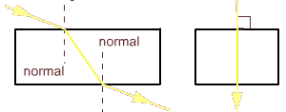
Light hitting
straight on is
not bent
Light hitting at an
angle is bent

Slide 18
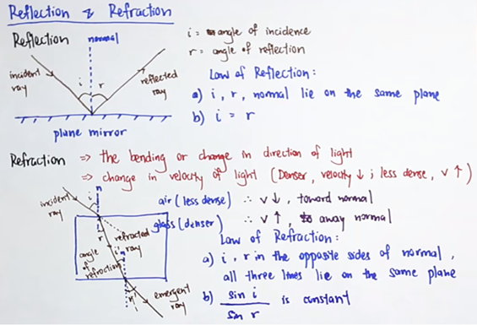

Slide 19

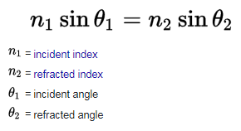
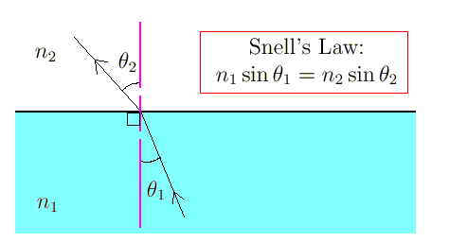
The Law of Refraction

Slide 20
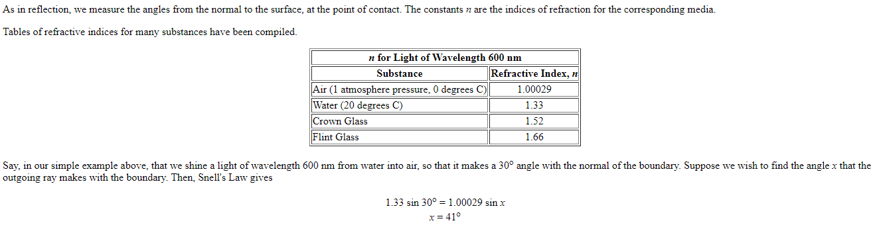

Slide 21
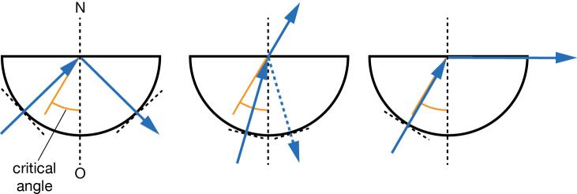
Total internal reflection

Slide 22
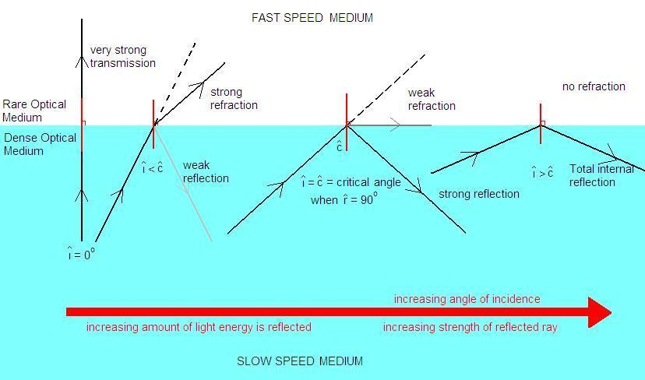

Slide 23
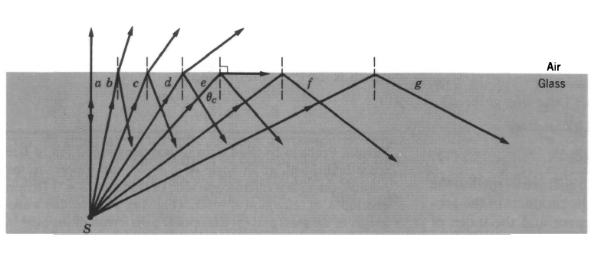
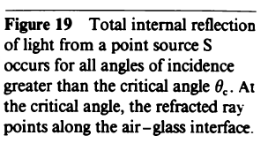

Slide 24
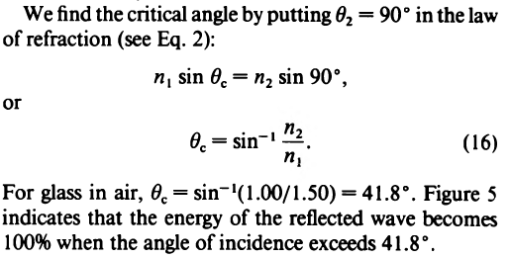

Slide 25
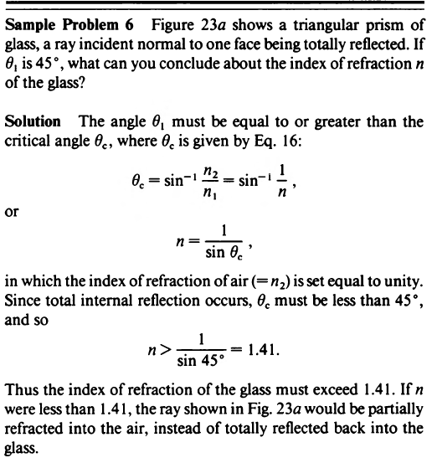

Slide 26
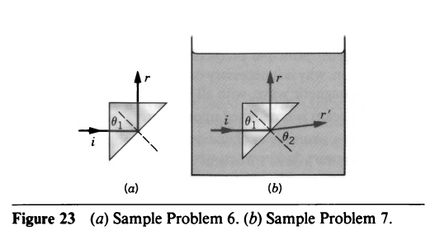

Slide 27
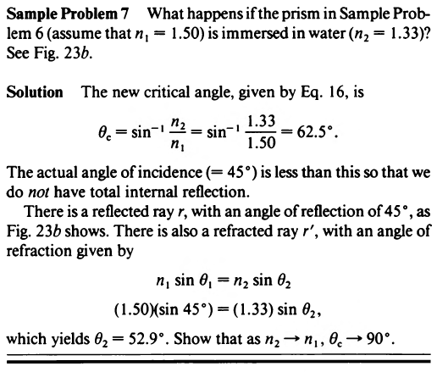

Slide 28
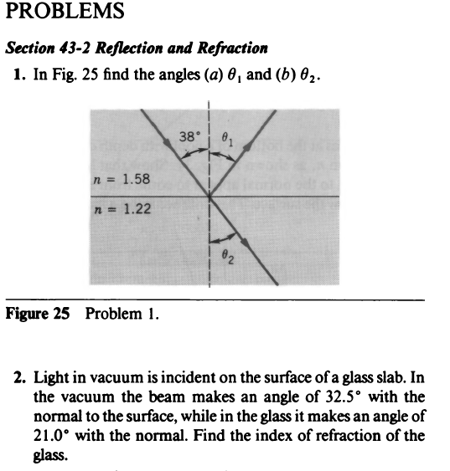

Slide 29
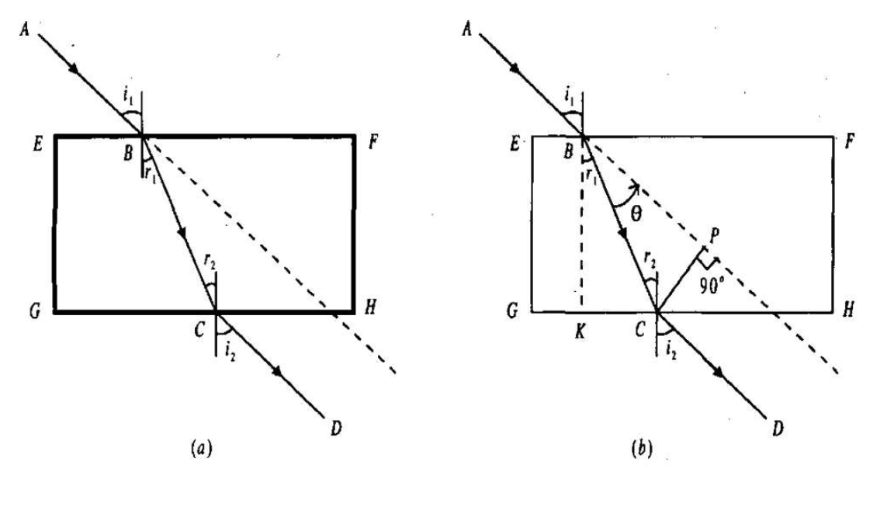
Optics Lab

Slide 30
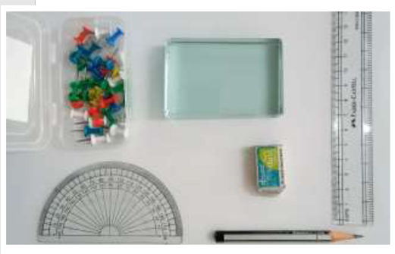
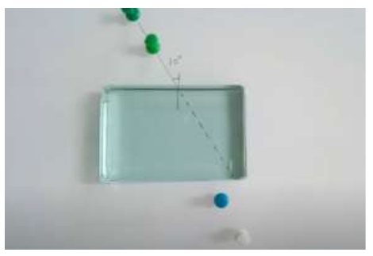

Slide 31
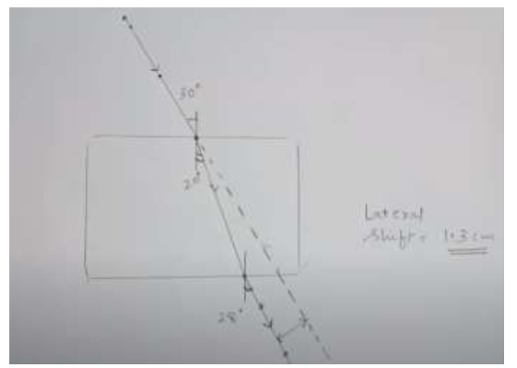

Slide 32
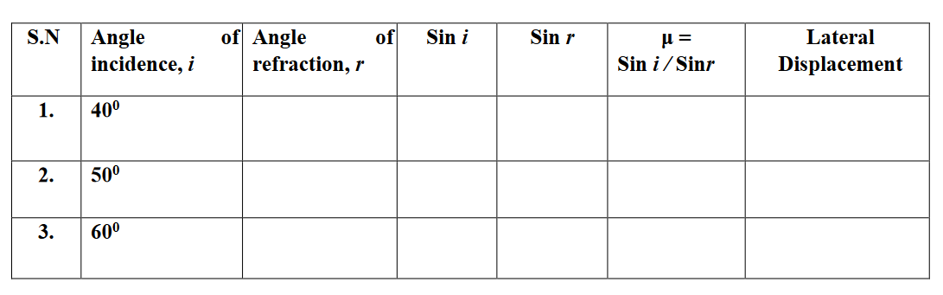

Slide 33
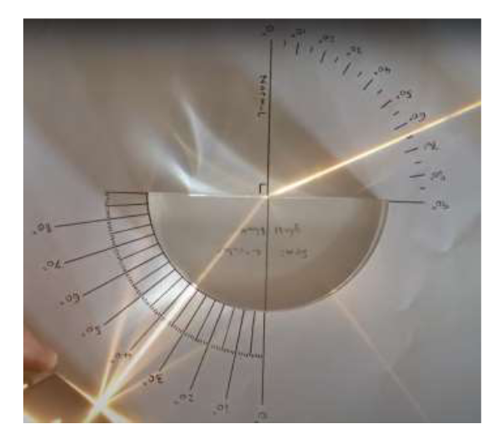

Slide 34
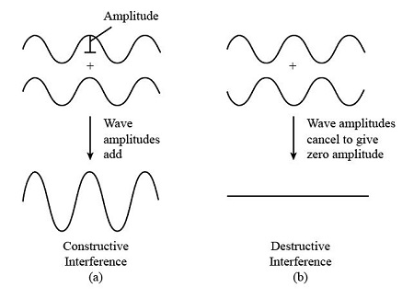
Light interference

Slide 35
Light interference
It is the phenomenon in which two waves superpose to form the resultant wave of the lower, higher or same amplitude. The most commonly seen interference is the optical interference or light interference. This is because light waves are randomly generated every which way by most sources. This means that light waves coming out of a source do not have a constant amplitude, frequency or phase.
The most common example of interference of light is the soap bubble which reflects wide colours when illuminated by a light source.
Example, incandescent bulbs generate a wide range of frequencies of light, including all colours of the rainbow. Moreover, the light coming out of the bulb is randomly generated every moment in all directions. This means that the starting point of the wave generated may be a maximum, a minimum or any point in between. There is no way of predicting which phase the wave will start. Such a source is said to be incoherent.

Slide 36
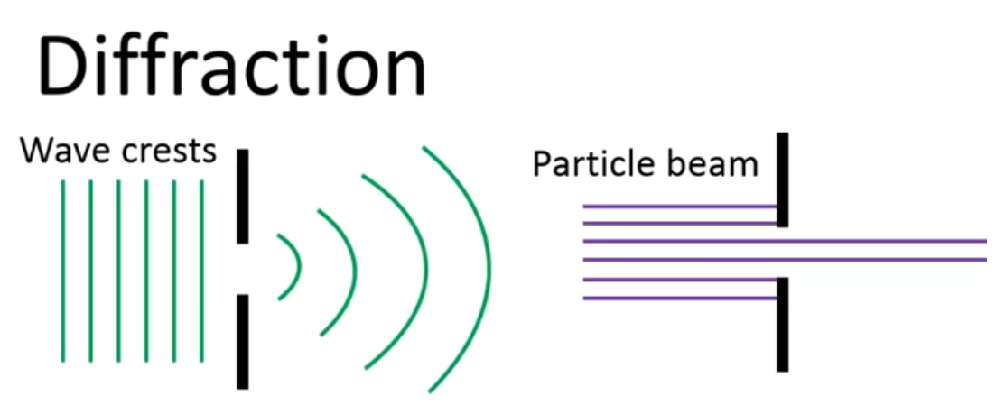
Diffraction
Diffraction refers to various phenomena that occur when a wave encounters an obstacle or opening. It is defined as the bending of waves around the corners of an obstacle or through an aperture into the region of geometrical shadow of the obstacle/aperture. The diffracting object or aperture effectively becomes a secondary source of the propagating wave.

Slide 37
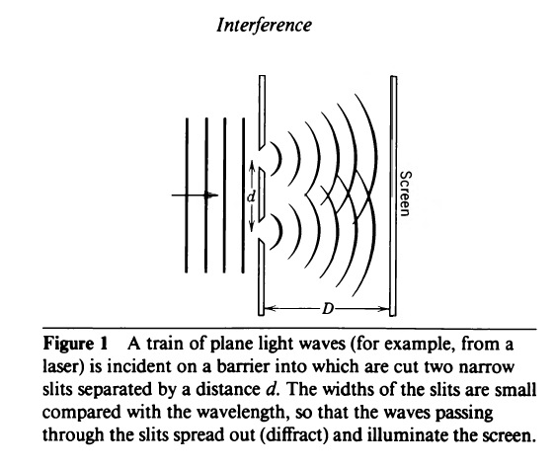

Slide 38
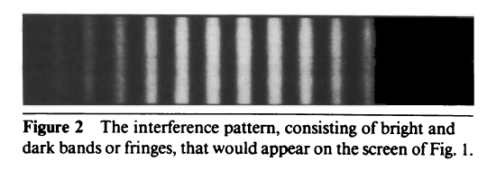

Slide 39
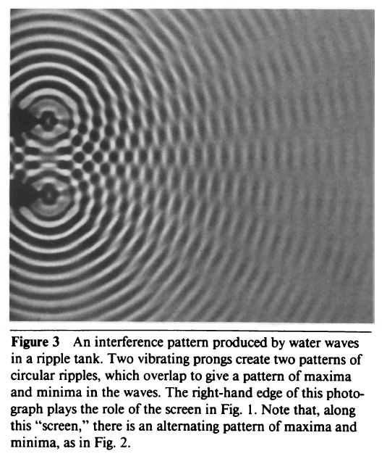

Slide 40
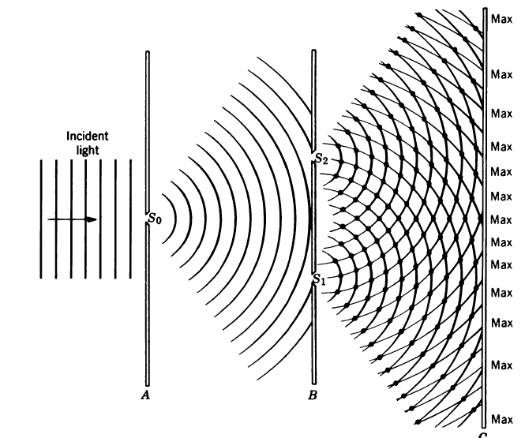

Slide 41
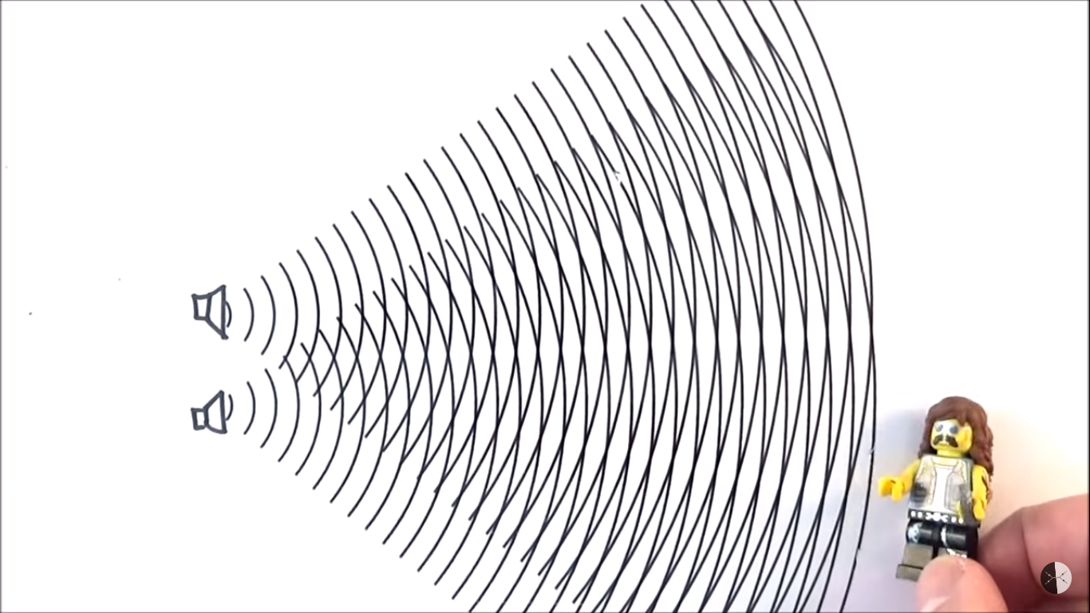
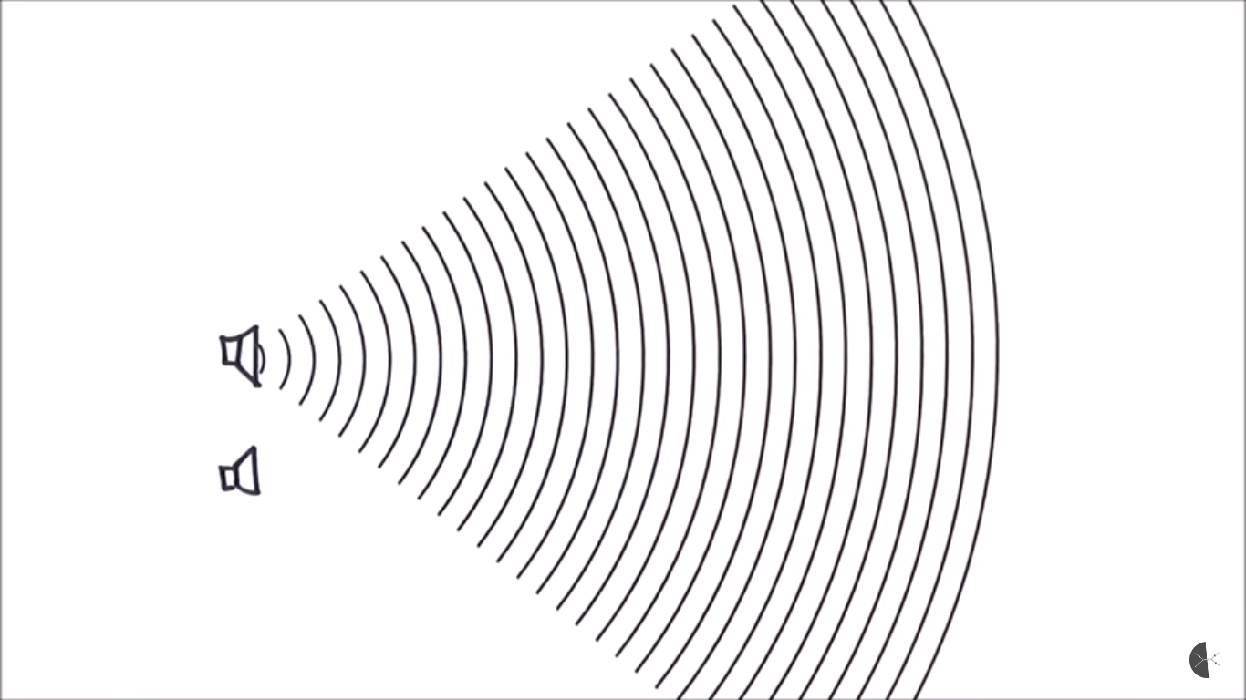
Two source interference

Slide 42
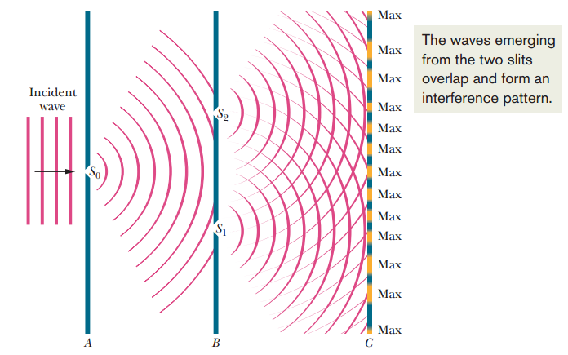
Double Slit interference

Slide 43
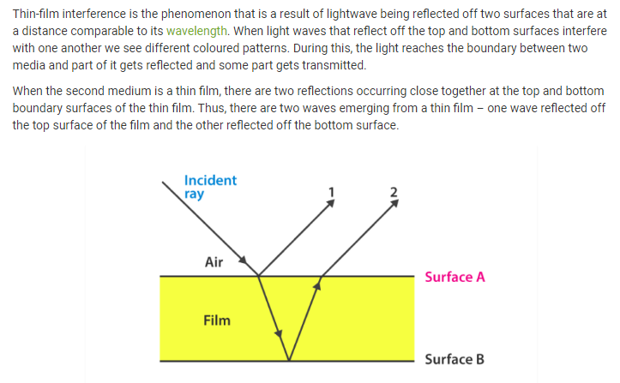
Interference from thin films

Slide 44
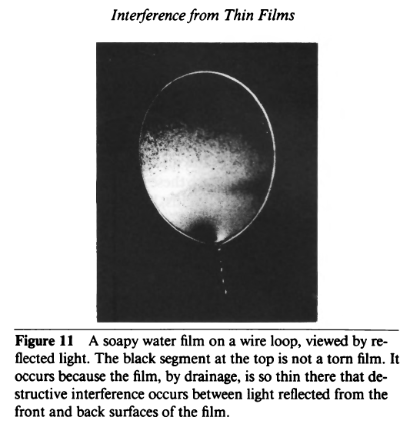

Slide 45
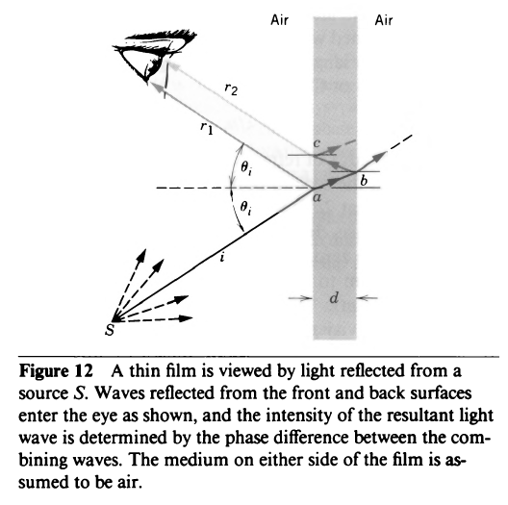

Slide 46
Diffraction and the wave theory
Diffraction refers to various phenomena that occur when a wave encounters an obstacle or opening. It is defined as the bending of waves around the corners of an obstacle or through an aperture into the region of geometrical shadow of the obstacle/aperture. The diffracting object or aperture effectively becomes a secondary source of the propagating wave.

Slide 47
Single-Slit Diffraction
Diffraction of light is defined as the bending of light around corners such that it spreads out and illuminates areas where a shadow is expected.
In the single-slit diffraction experiment, we can observe the bending phenomenon of light or diffraction that causes light from a coherent source to interfere with itself and produce a distinctive pattern on the screen called the diffraction pattern. Diffraction is evident when the sources are small enough that they are relatively the size of the wavelength of light.

Slide 48
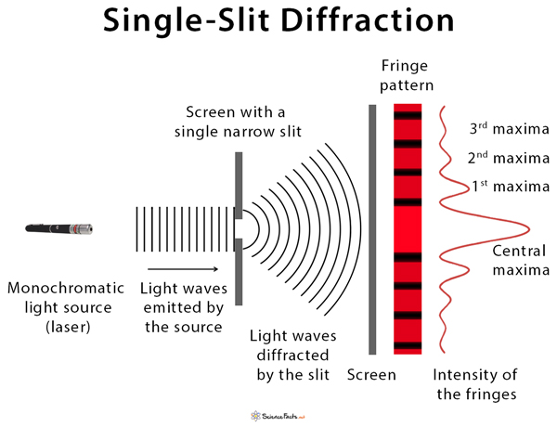

Slide 49
What is phase difference?
Phase difference is defined as the difference between any two waves or the particles having the same frequency and starting from the same point. It is expressed in degrees or radians.
What is the condition for constructive interference?
The condition for constructive interference is that the path difference should be equal to an integral multiple of the wavelength.
What is the condition for destructive interference?
The condition for destructive interference is that the path difference should be equal to odd integral multiple of half wavelength.

Slide 50
Polarization of electromagnetic waves
An electromagnetic wave such as light consists of a coupled oscillating electric field and magnetic field which are always perpendicular to each other; by convention, the "polarization" of electromagnetic waves refers to the direction of the electric field. In linear polarization, the fields oscillate in a single direction. In circular or elliptical polarization, the fields rotate at a constant rate in a plane as the wave travels.
Polarization is a property applying to transverse waves that specifies the geometrical orientation of the oscillations. In a transverse wave, the direction of the oscillation is perpendicular to the direction of motion of the wave.
In contrast, in longitudinal waves, such as sound waves in a liquid or gas, the displacement of the particles in the oscillation is always in the direction of propagation, so these waves do not exhibit polarization. Transverse waves that exhibit polarization include electromagnetic waves such as light and radio waves, gravitational waves, and transverse sound waves in solids.

Slide 51
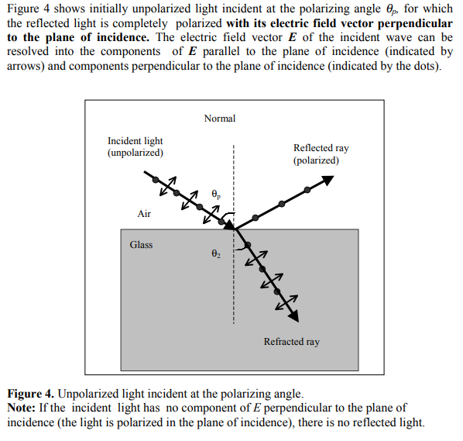

Slide 52
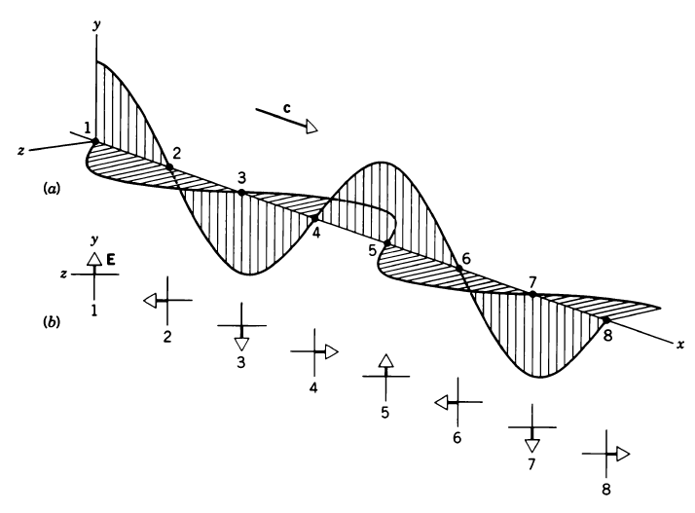

Slide 53
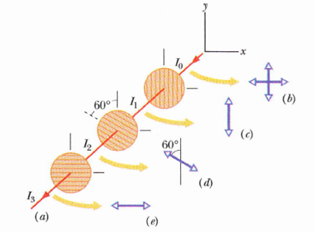
Polarizing sheets
A polarizer is an optical filter that lets light waves of a specific polarization pass through while blocking light waves of other polarizations.

Slide 54
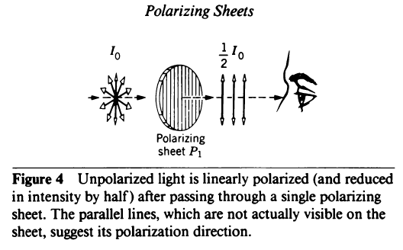

Slide 55
